Slide 2
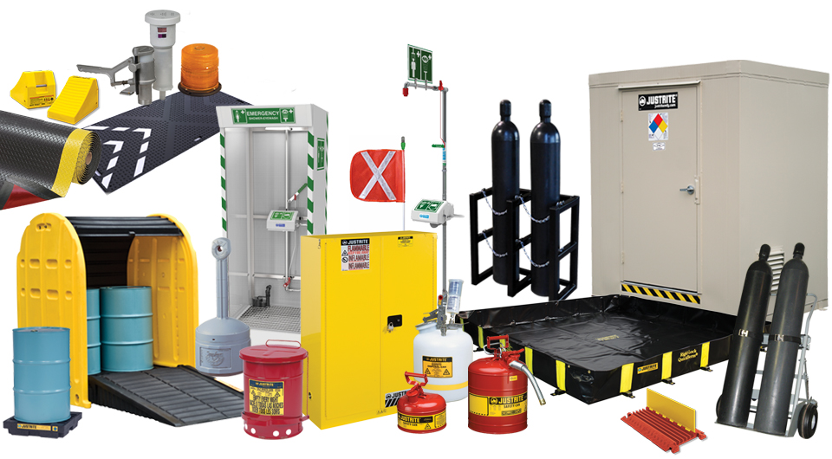
Largest Provider of Non-PPE Industrial and Environmental Safety Products
Since 1906, Justrite has been recognized as an industry leader in the safe management of flammable liquids and other hazardous materials. Today our products include safety cabinets and large outdoor storage buildings, safety vessels and containers for laboratory and industrial applications, spill containment, secondary spill containment, safety showers and eye/face washes, gas cylinder handling equipment, and a range of custom engineered solutions.
Safety Cabinets
Safety Cans & Containers
Emergency Eye & Safety Showers
Gas Cylinder Handling
Drum Safety Equipment
Flexible Spill Containment
Rigid Spill Containment
Outdoor Storage Lockers
Industrial Matting
Motion Safety
Cable Management
Ground Protection
Material Handling
Hazardous Waste Drums
5S
Safety Signs
Lockout/Tagout
These products are available to our valued channel partners world-wide.

Slide 3
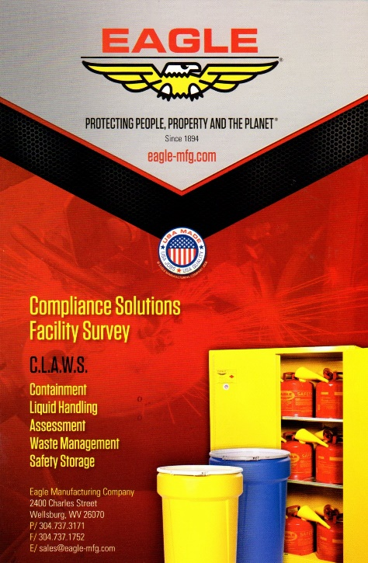
STUDE Safety Survey
Justrite's free consultative survey, provided in a comprehensive format — known as STUD-E for STORAGE, TRANSFER, USE, DISPOSAL, and EVALUATION of flammable liquids — addresses the inherent concerns with handling volatile hazardous liquids. The results prevent catastrophic fires, protect your people from potential injuries or death, protect the environment to meet sustainability initiatives, and assure compliance to OSHA and EPA regulations

Slide 4
Summary
Comprehensive line of approved products to serve facilities who have safety and compliance needs.
Expertise in chemical, environmental, operator and identification safety.
Increase Overall Safety in Your Workplace.
Let Us Know How We Can Help

